Slide 1
CSC3170 Group Project
Campus Used Books
Online Trading Platform Database Design
Group members:
徐瀚翔 121040076 李康硕 121090271
李政达 121090303 王家驹 121090544
李聿晨 121090298 田镭 121090515
谈常睿 121090504 赵梦澜 120090232

Slide 2
CONTENT
Introduction and Motivation
01
ER Diagram Design
02
Database Setup
03
Sample Queries
04
Webset Display
05

Slide 3
Introduction & Motivation
01

Slide 4
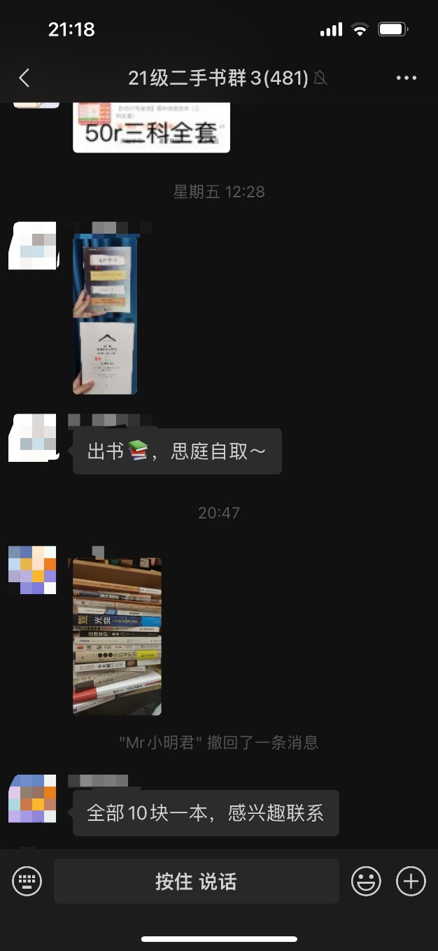
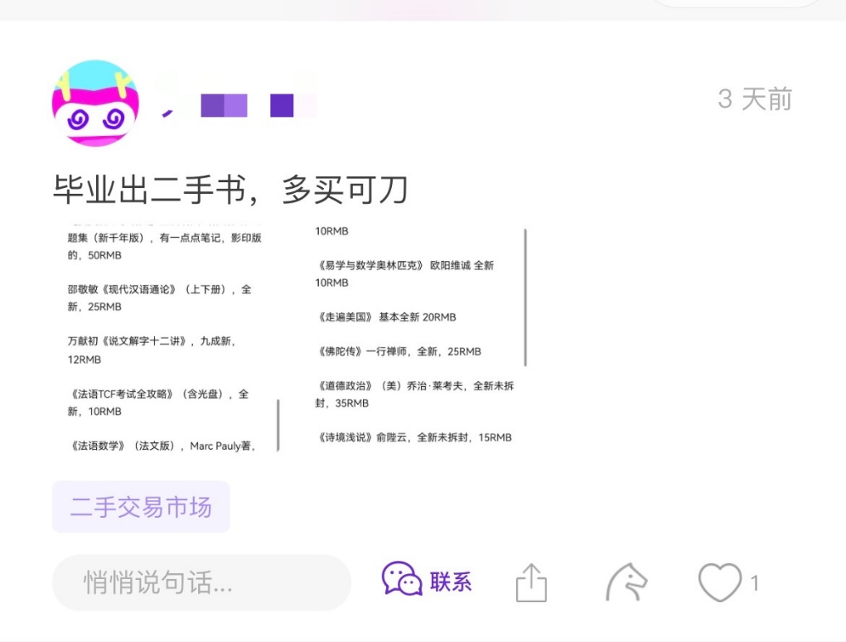
Problem
01
· Information overload
· Low transaction efficiency
03
02
· Inventory management challenges
· Communication difficulties
04
Online Trading Platform

Slide 5
Analyze
·The database should store information about books, staff and order details.
·Two products. One is second-hand book
and the other is notes.
Database
·All product transactions are completed online, and the products are transferred between the express station and store selected by the user.
·Two types of staff, salesperson and delivery man, who are responsible for the transaction and transportation of books.

Slide 6
Assumption
1
Each time a user can buy multiple products in an sale order through only one salesperson and delivered by only one delivery man.
2
There are only 2 kinds of products: notes and books
3
There are only 2 kinds of staff: salesperson and delivery man
4
One salesperson only works in one store and one store can have multiple salespersons. Every store needs to employ salespersons.
5
One delivery man is responsible for multiple express stations and one express station can have several delivery men.
6
One user can own many orders and one order belongs to only one user.
7
One user can own many orders and one order belongs to only one user.
An order is either for the user to sell second-hand products to the store, or for the store to sell products to the user. All transactions are completed online.
8
9
The transportation of products is done between express stations and stores.

Slide 7
ER Diagram Design
02

Slide 8
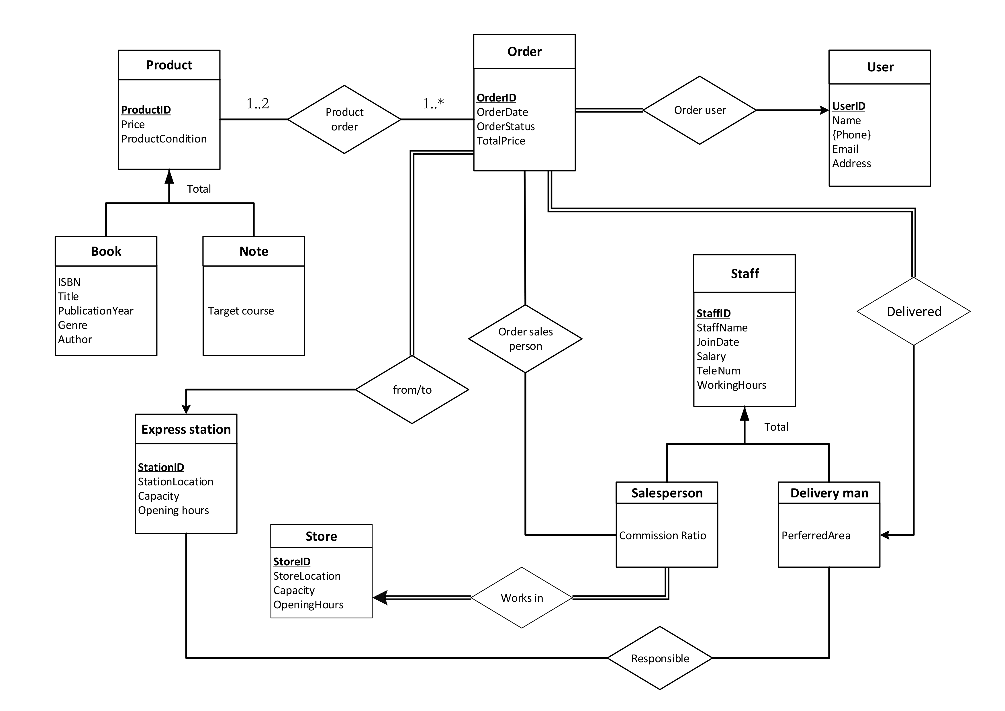
ERD Overview

Slide 9
ERD Design
Product
User
Order
ProductID
Price
ProductCondition
UserID
Name
{Phone}
Email
Address
OrderID
OrderDate
OrderStatus
TotalPrice

Slide 10
Normalization
Book {ProductID, price, author, ProductCondition, Title, ISBN, genre, Publication_Year}
PK
3NF
PK
book1: {ProductID, price, ProductCondition, ISBN, PublicationYear}
PK
book2: {ISBN, author, title, genre}
PK
note: {ProductID, price, ProductCondition, target_course}
PK
FK
Order_Product {Order_ID, product_ID}
PK
FK
FK
FK
FK
Order {OrderID, OrderDate, Status, express_station_ID, delivery_man_ID, user_ID, salesperson_ID}

Slide 11
FK
User {ID, name, email, address, phone}
1NF
user {ID, name, email, address}
user_telephone {ID, phone}
PK
FK
salesperson {StaffID, name, joined_date, salary, tele_num, working_hours, commissionRatio, Store_ID}
responsible {delivery_man_ID, express_station_ID}
ExpressStation {StationID, StationLocation, Capacity, OpeningHours}
PK
Store {StoreID, StoreLocation, Capacity, OpeningHours}
Deliveryman {StaffID, name, joined_date, salary, tele_num, working_hours, preferredArea}
PK

Slide 12
Database Setup
03

Slide 13
Table Setup and Data Insertion
Create Tables
Retrieve Real Data
Generate Simulated Data
Create the tables based on the relational schema
3
2
Make up staff, user information
21 staffs, 30 users
Use Python to consistently simulate orders information, order-product table.
200 Products, 76 Orders, 344 Order-Products.
1
Book Information (ISBN, Title, Publication year, Genre, Author) Retrieved from Amazon
Engage with ChatGPT to refine the organization of the tables

Slide 14
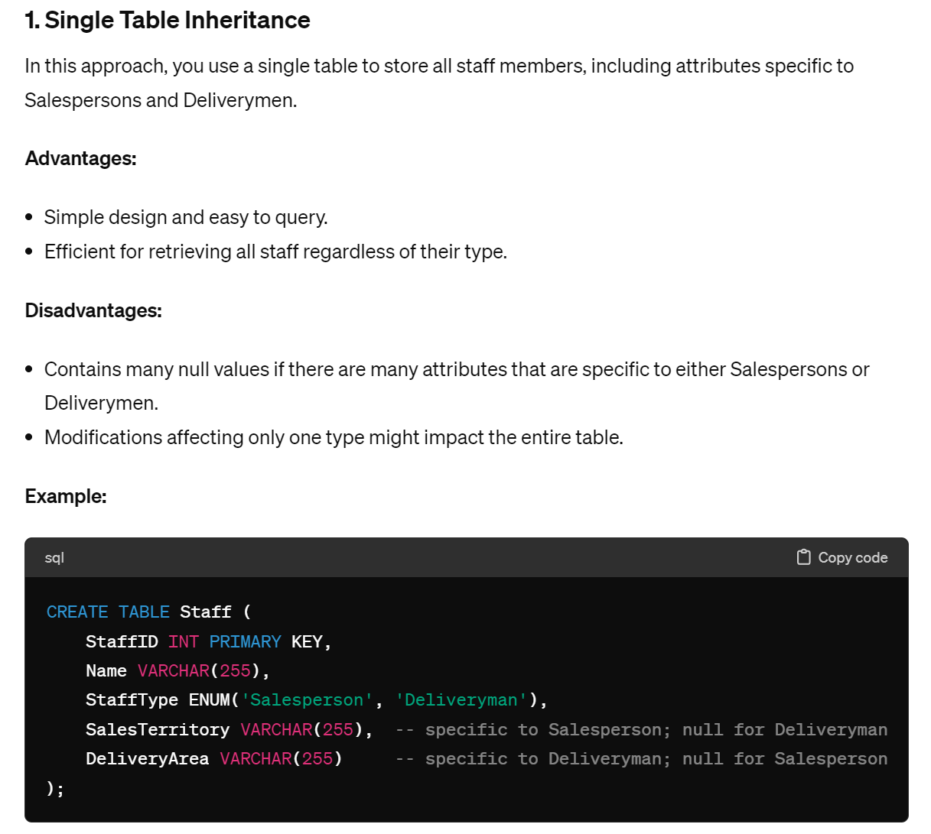
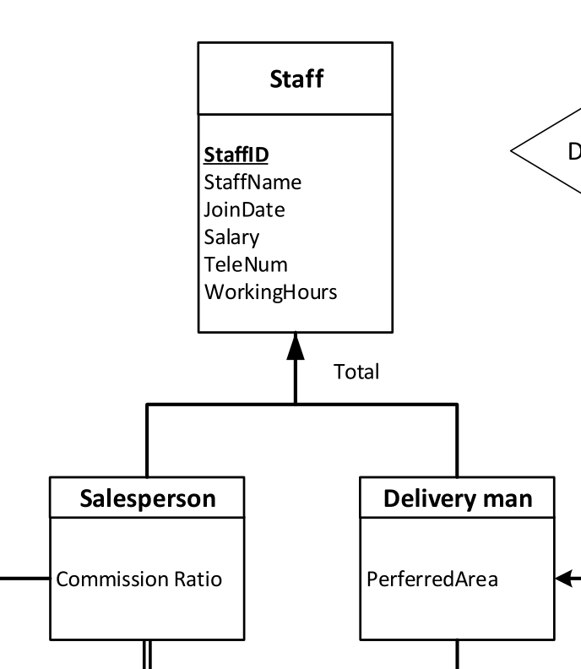
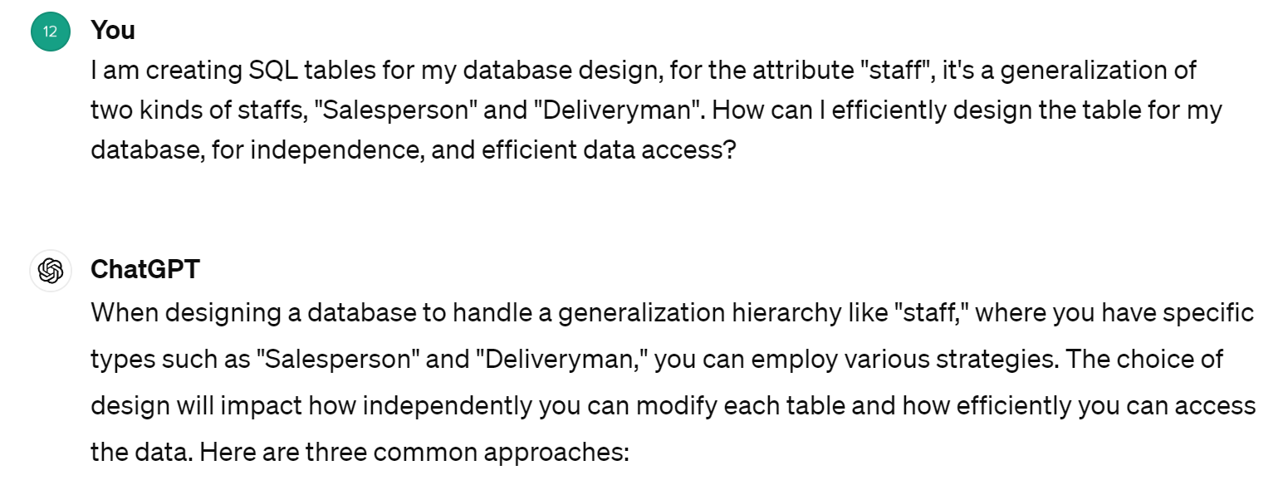
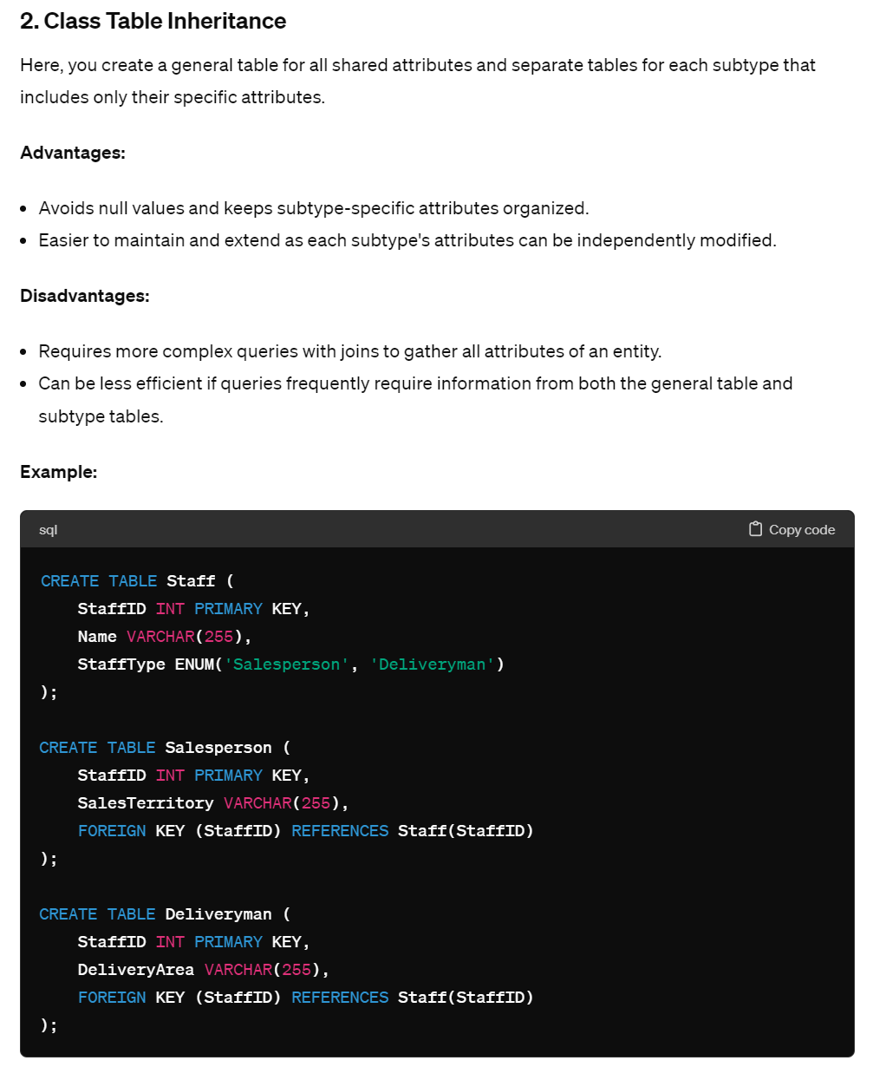
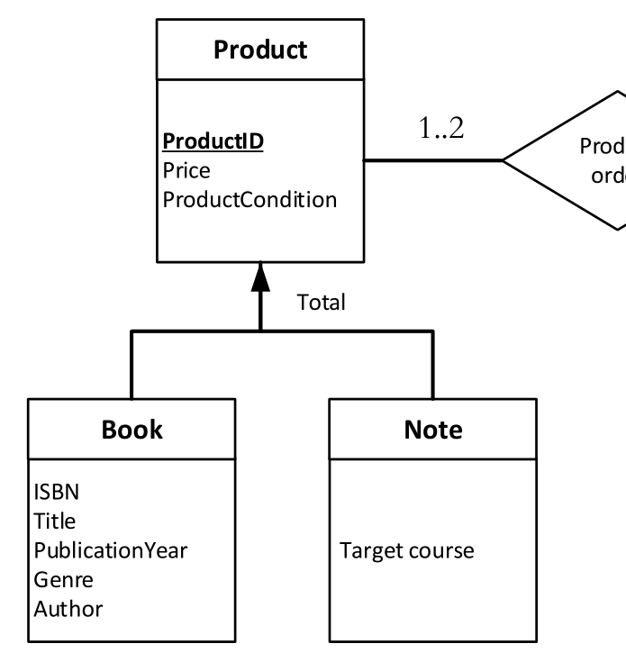
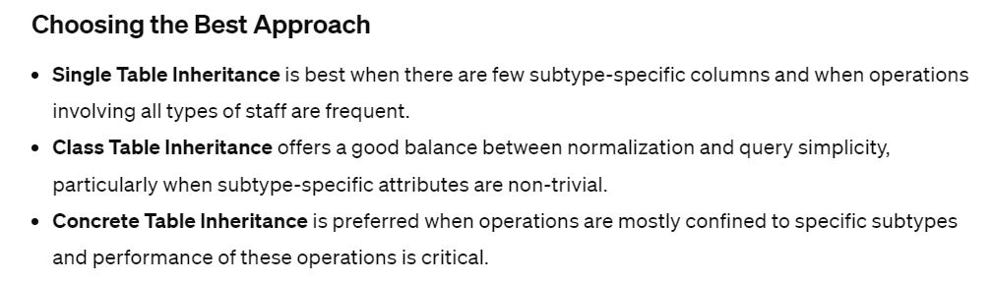
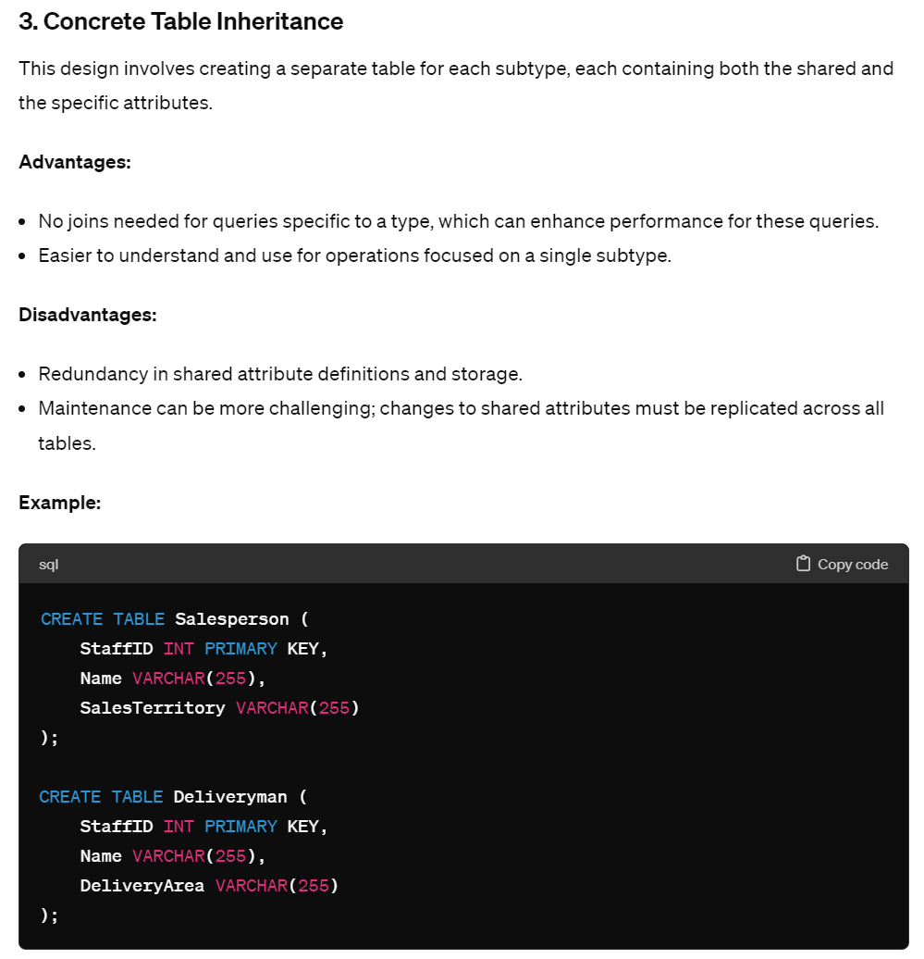
Create tables via relational schema
Engage with ChatGPT

Slide 15
Sample Queries
04

Slide 16
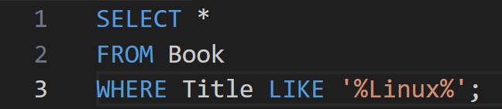
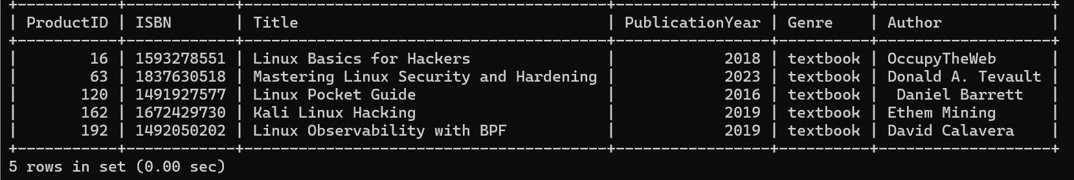
Sample Queries Used for Daily Operations
Find the books in the Book table where the Title contains “Linux”.

Slide 17
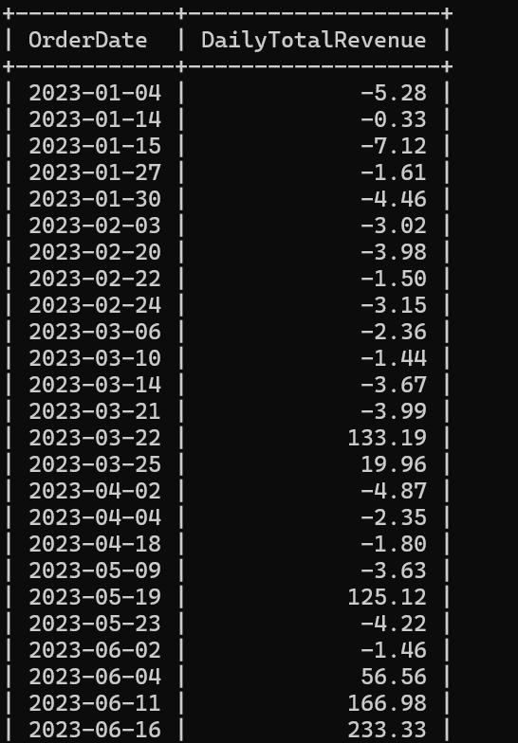
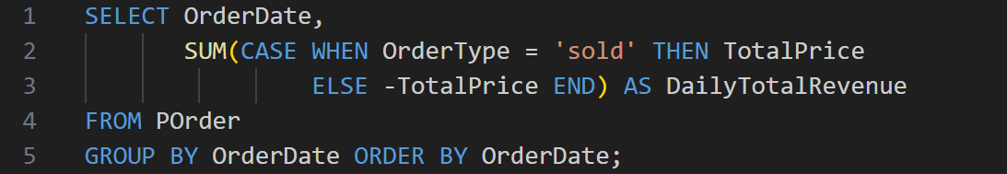
Sample Queries Used for Daily Operations
Find the total sales revenue for each date from the orders in the database.

Slide 18
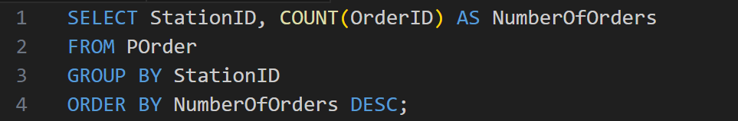
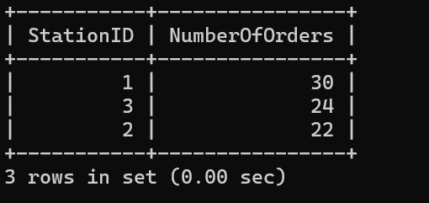
Sample Queries Used for Daily Operations
Calculate the total number of orders for each express station.

Slide 19
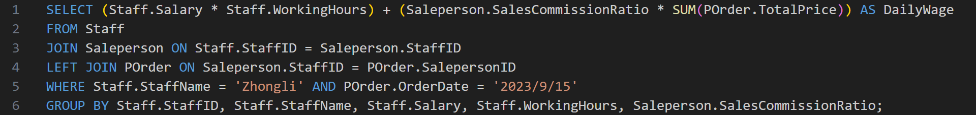
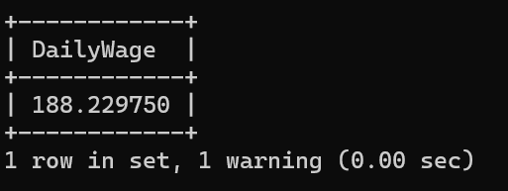
Sample Queries Used for Daily Operations
Calculate the daily wage for the salesperson named “Zhongli” on 2023/9/15, based on his salary and sales commission ratio.
Revenue = Salary * WorkingHours + SalesCommissionRatio * (Money helped earned that day)

Slide 20
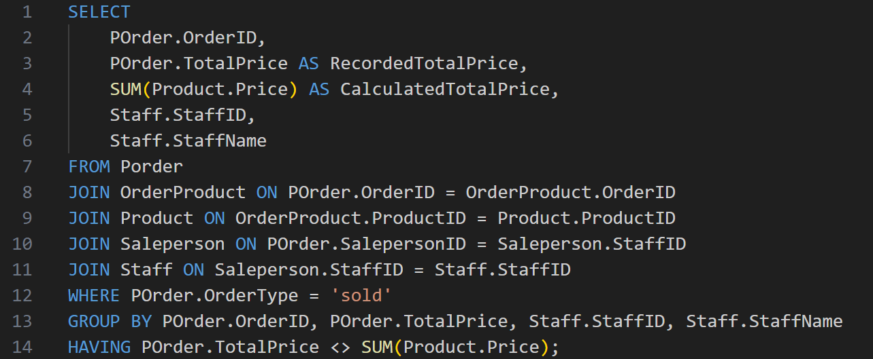
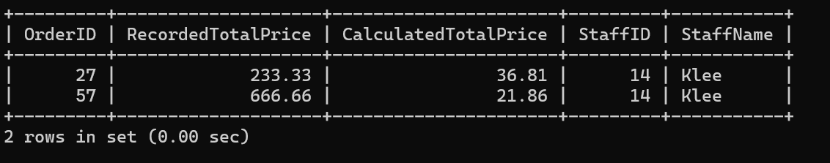
Sample Queries Used for Daily Operations
Detect anomaly records for TotalPrice in the Porder table and show the Saleperson who processed it.

Slide 21
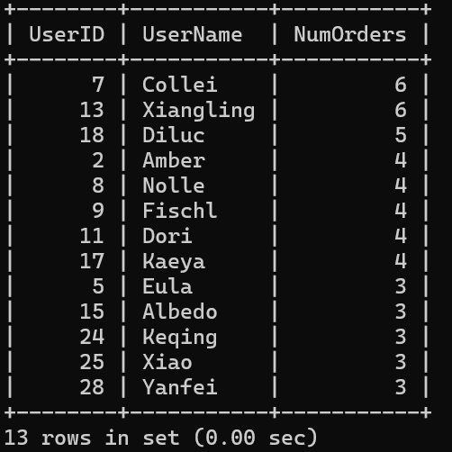
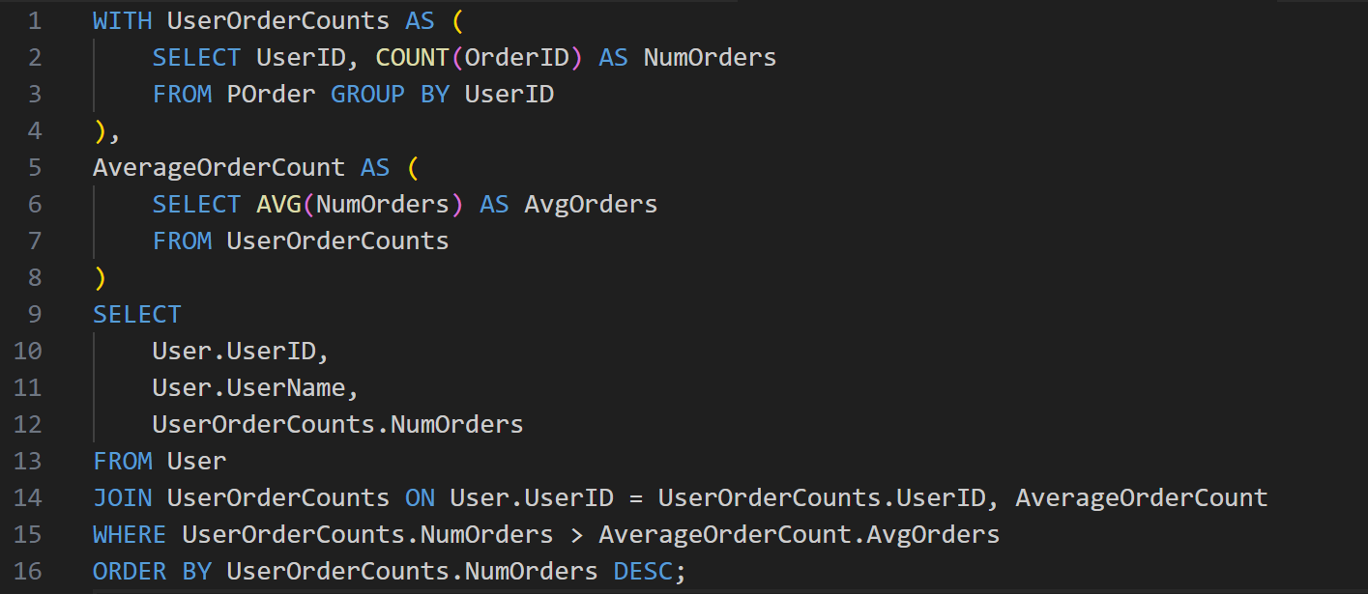
Sample Queries for Data Mining Purposes
Select active users based on their number of orders (order count above average).

Slide 22
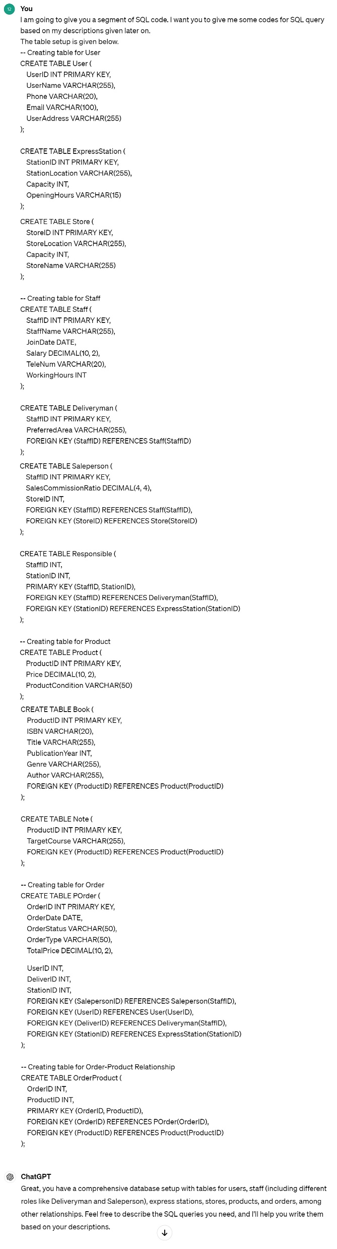
Prompts That Guide ChatGPT to Accurately Generate Queries

Slide 23
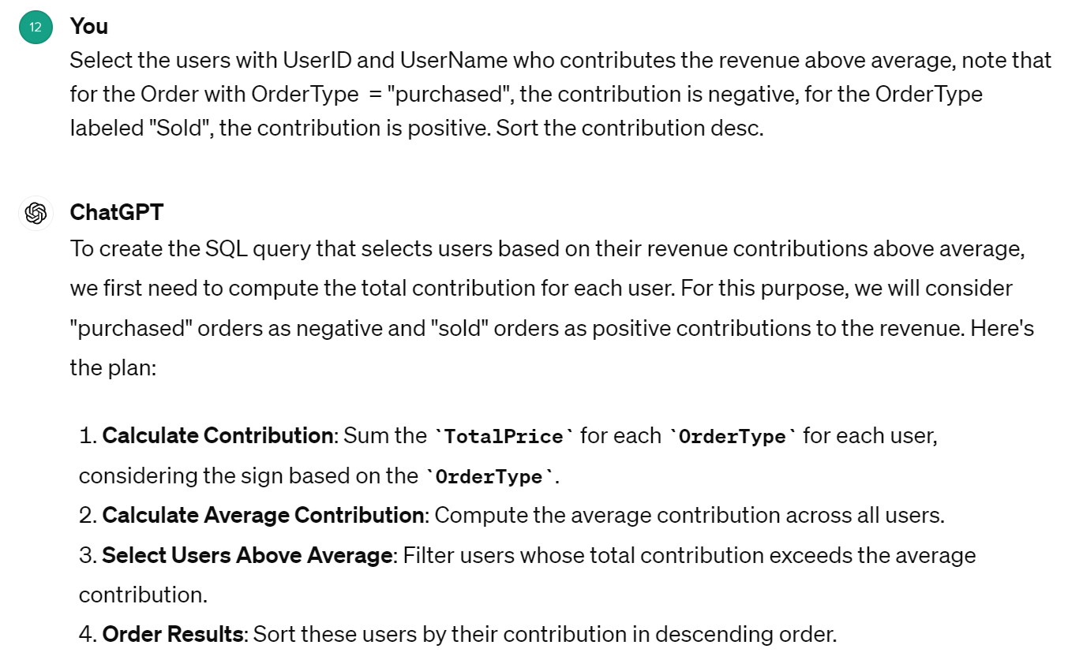
Prompts That Guide ChatGPT to Accurately Generate Queries
Select the users who contributes to the total revenue above average

Slide 24
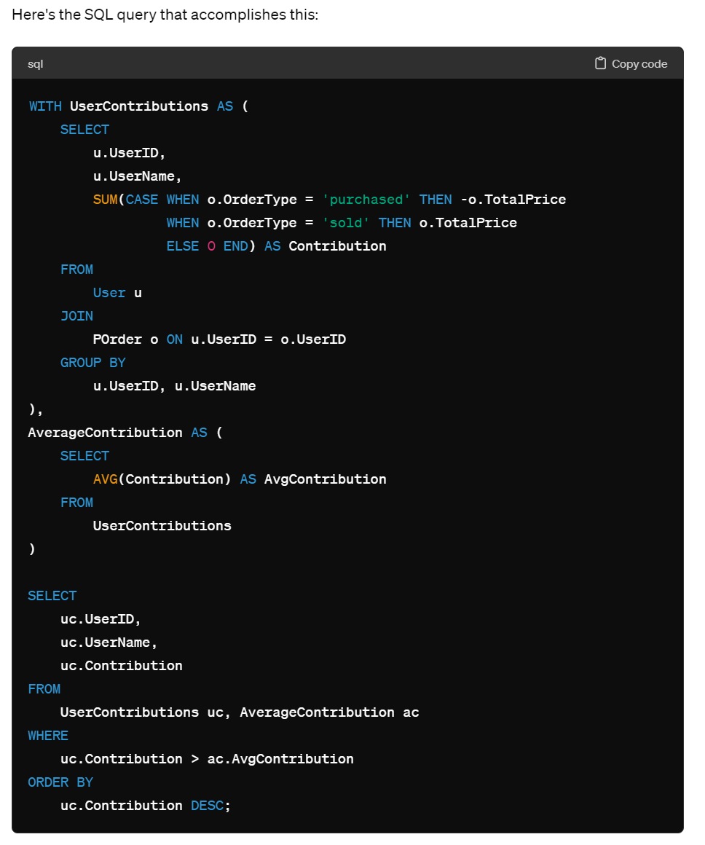
Prompts That Guide ChatGPT to Accurately Generate Queries

Slide 25
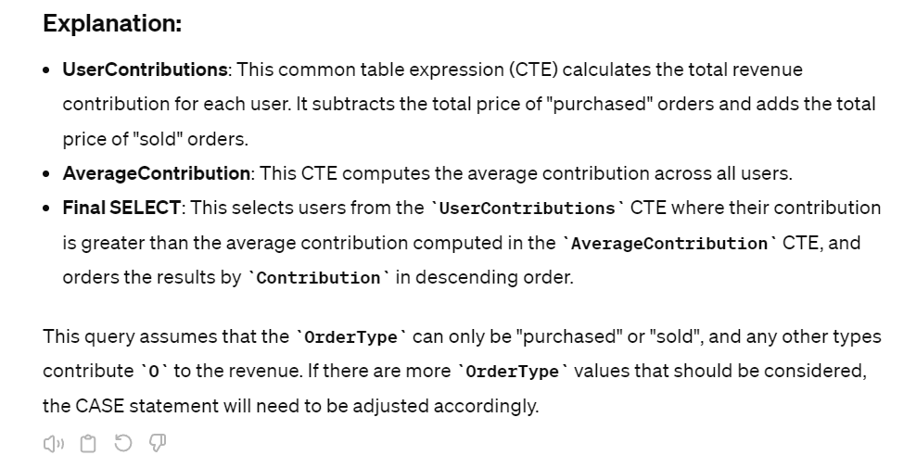
Prompts That Guide ChatGPT to Accurately Generate Queries

Slide 26
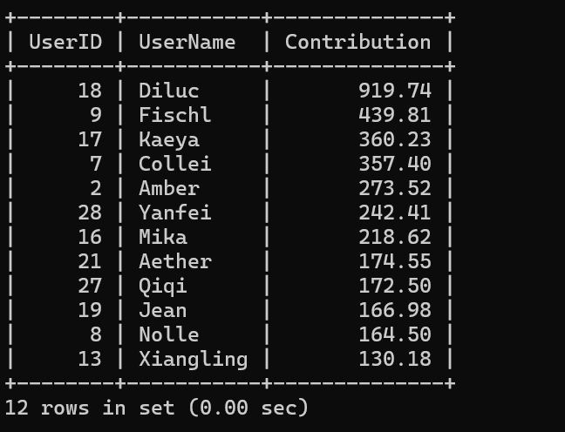
Prompts That Guide ChatGPT to Accurately Generate Queries
Select the users who contributes to the total revenue above average

Slide 27
Webset Display
05

Slide 28




Tools Used
Maven
Navicat
MySQL
IDEA

Slide 29
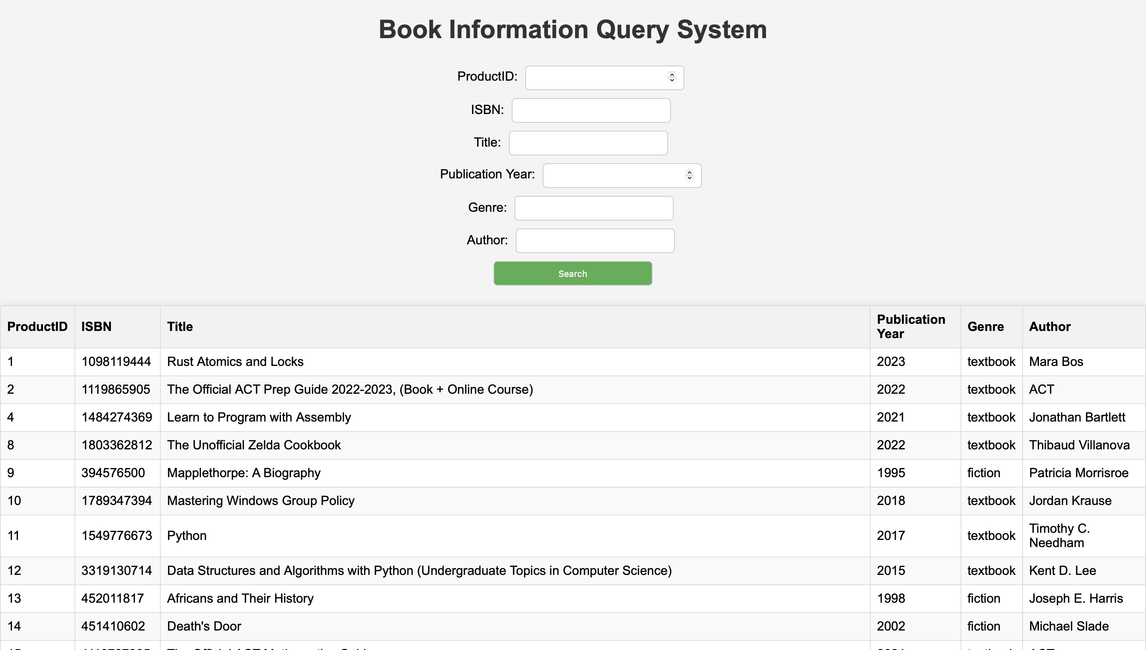
Webset Homepage

Slide 30
Thanks for your Attention.

